Slide 1
AML Project
Data Preprocessing and Feature Engineering
Abhimanyu Swaroop (as6434), Wanru Hu(wh2483), Xiaorui Qin (xq2209), Binghong Yu (by2325), Karveandhan Palanisamy (kp2941)

Slide 2
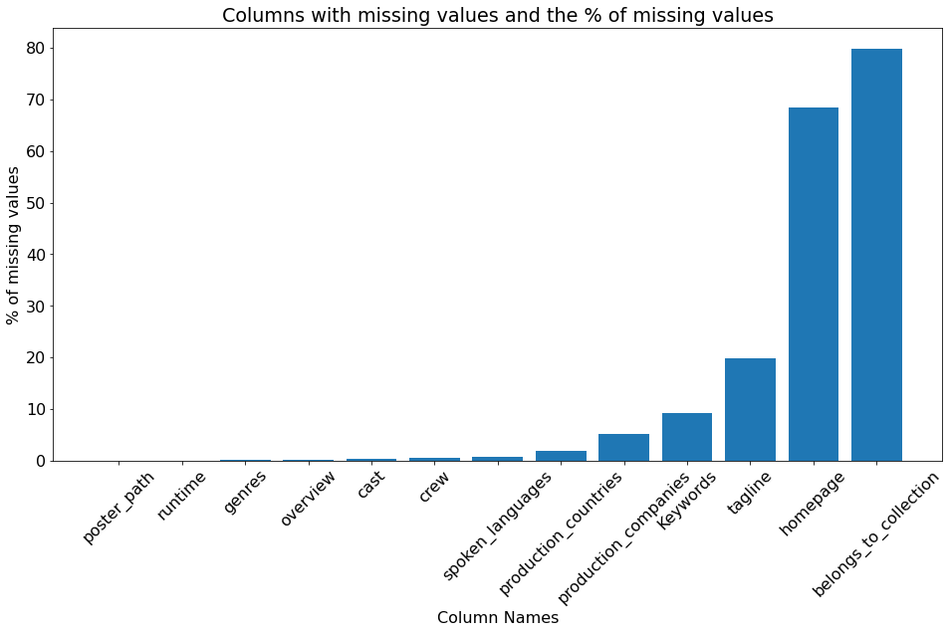
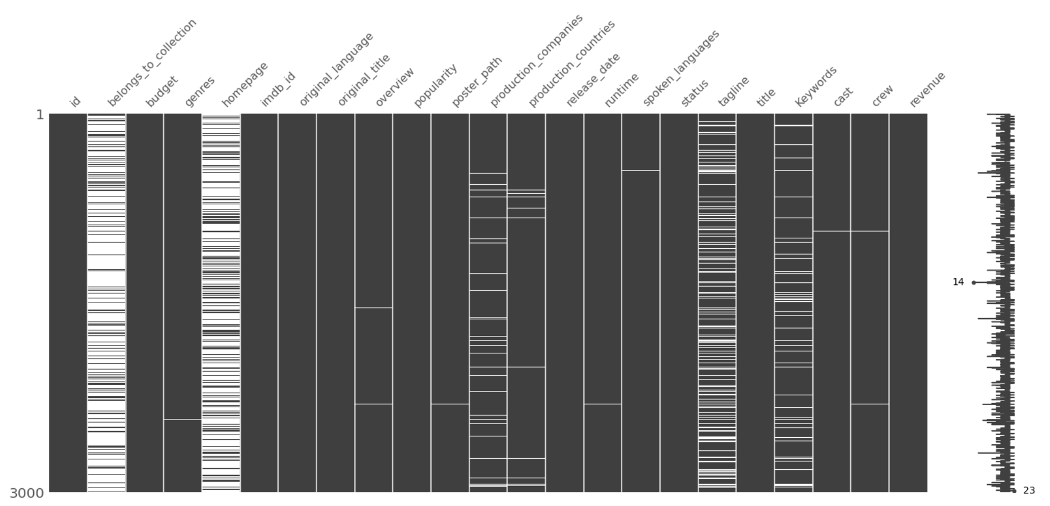
Missing data
Dropping Columns with more than 10% missing values (belongs_to_collection, homepage, tagline)

Slide 3
Feature Engineering and Preprocessing
Preprocessing Applied:
Dropping columns with missing values greater than 10% and columns that contained links to images/webpages
Missing values for ‘budget’ is filled with the average value for movies shot that year in that country
Missing values for categorical data are left to be their own category
Applying log transformation to ‘revenue’ and ‘budget’ thus make it more robust to outliers
Text data is converted into tf-idf matrix
Extracting weekday, day, month, year from ‘release_date’
Columns: ‘belongs_to_collection', 'genres', 'production_companies', 'production_countries', 'spoken_languages', 'Keywords', 'cast', and 'crew' are stored in JSON format. They are converted to dictionaries and features are stored as lists which are one-hot-encoded
The lists from JSON columns are used to create count features (number of actors, number of companies etc.)

Slide 4

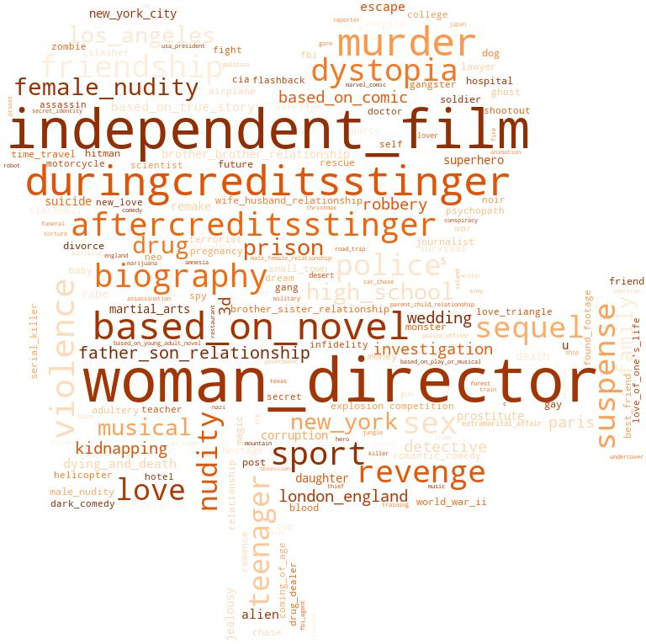
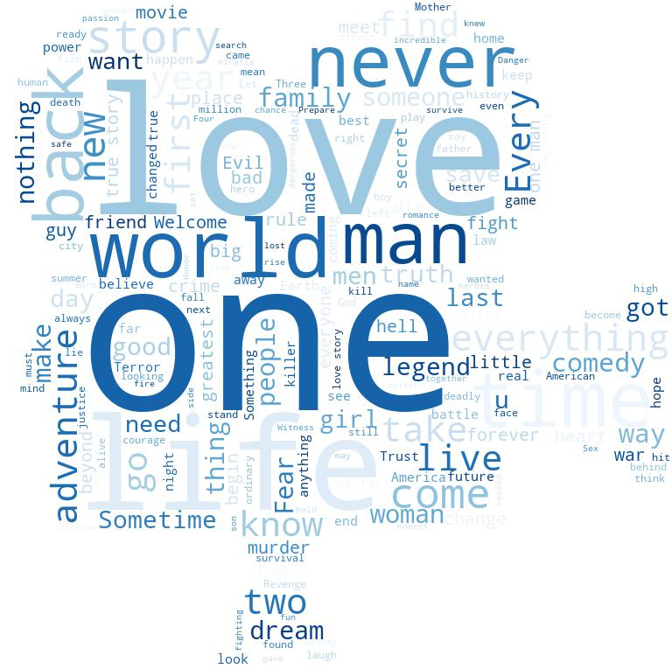
Preprocess and Word Cloud of text features
Word Cloud for Overview
Word Cloud for Keywords
Word Cloud for Tagline
For features “overview”, “Keywords”, “tagline”, we remove the punctuation and stopwords. From the word cloud, we could find some most important words in these features separately, e.g., “find” and “life” for “overview”, “woman_director” and “independent_film” for “Keywords”, and “love” and “one” for “tagline”
Text features are represented as tf-idf matrix for the purpose of fitting a model

Slide 5
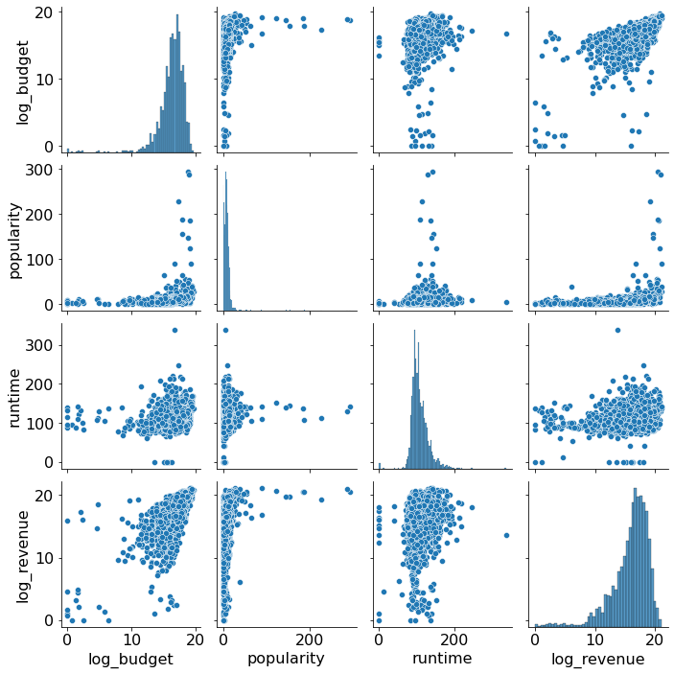
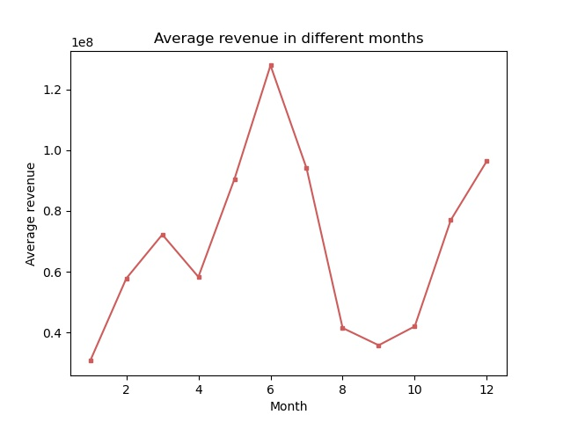
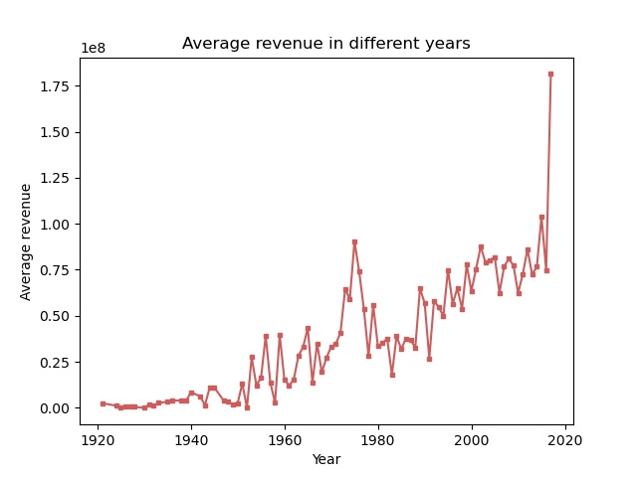
Numerical trends in data
- From the plots we can infer that there is no linear relationship between the target variable and the features
- We can notice that revenue peaks during certain months (summers) and has an increasing trend over time
- In general, higher budget results in higher revenue
- High popularity implies higher revenue but higher revenue does not imply high popularity

Slide 6
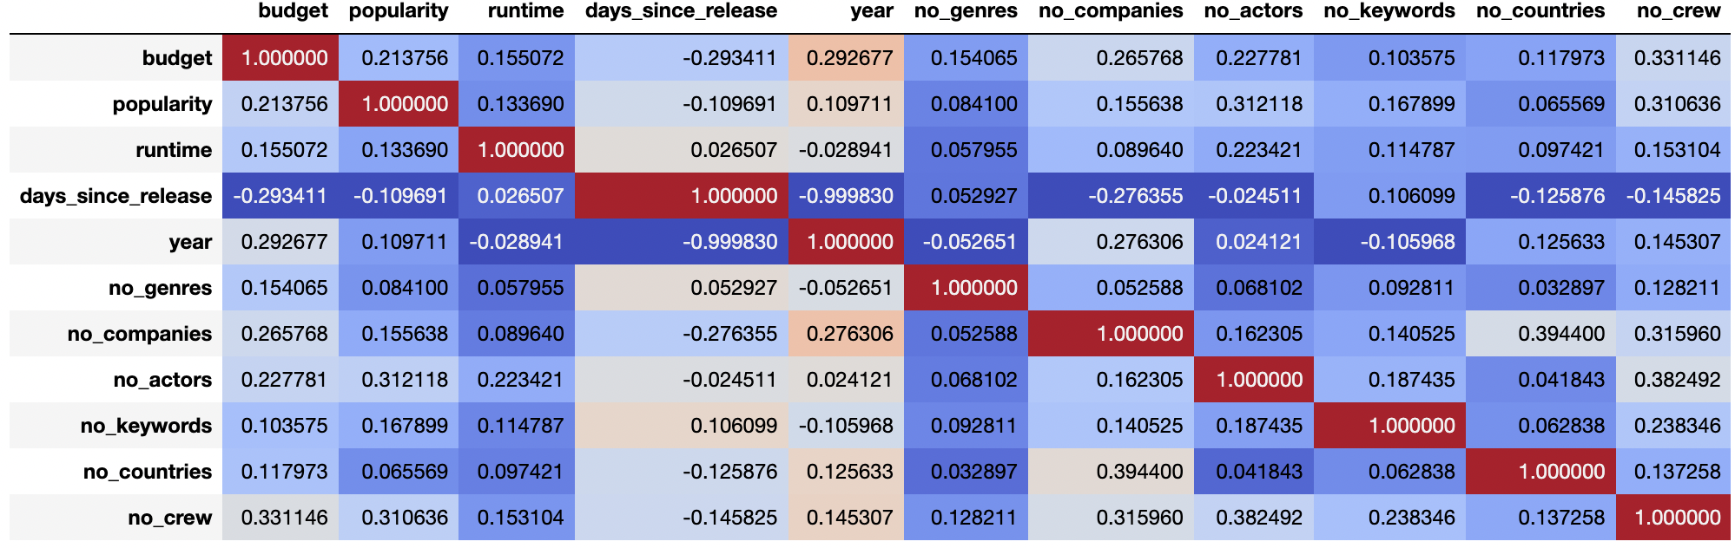
Correlation plot after feature engineering
From the correlation matrix we can see that no two features are highly correlated. Therefore, we do not drop any features.

Slide 7
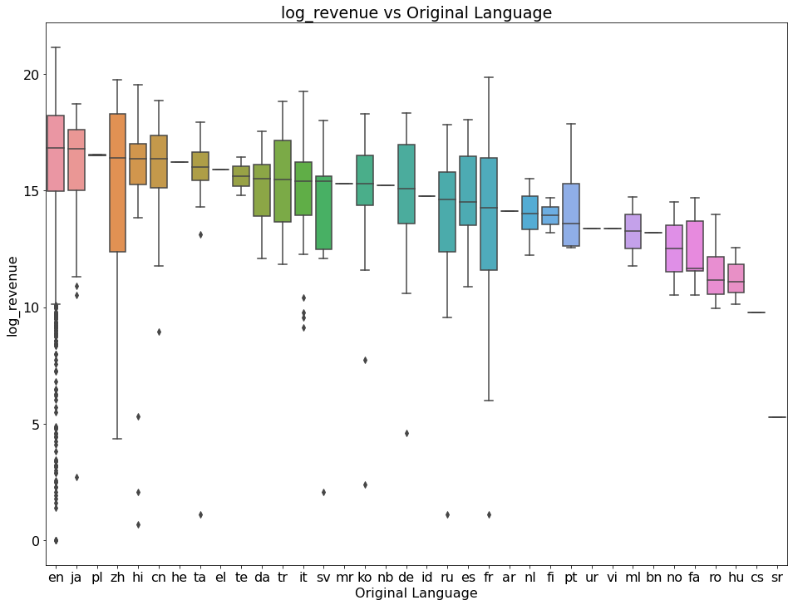
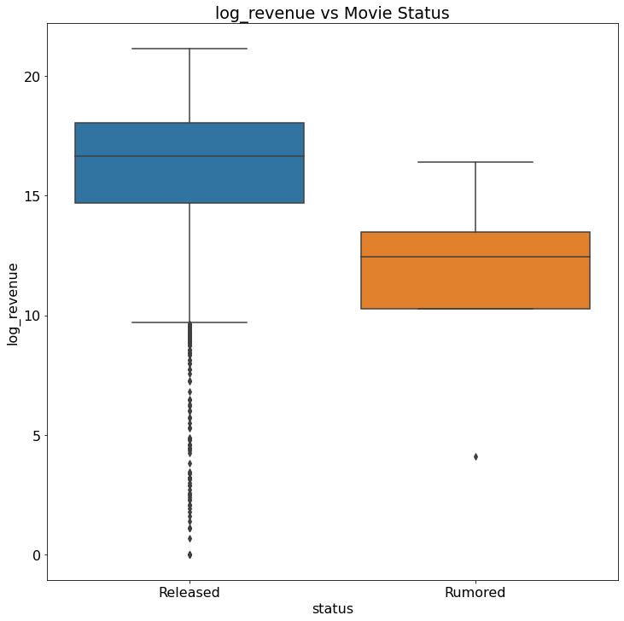
Noticeable Trends among categorical features
Note: Revenue is log-scaled therefore a small difference on y-axis is in reality a huge difference in the revenue.
We can see that some languages have a much higher revenue as compared to other languages. This can be an important distinguishing feature. We also notice that the ‘status’ feature has significantly different distributions for revenue

Slide 8
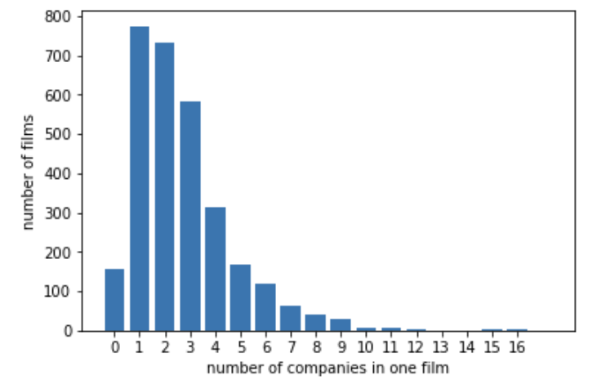
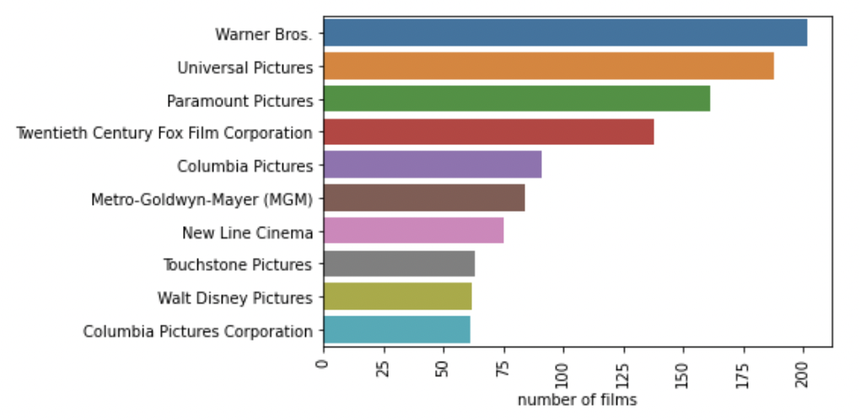
Production Companies
Most movies have 1 or 2 companies. And Warner Bros, Universal Pictures and Paramount Pictures produced top 3 amounts of films.

Slide 9
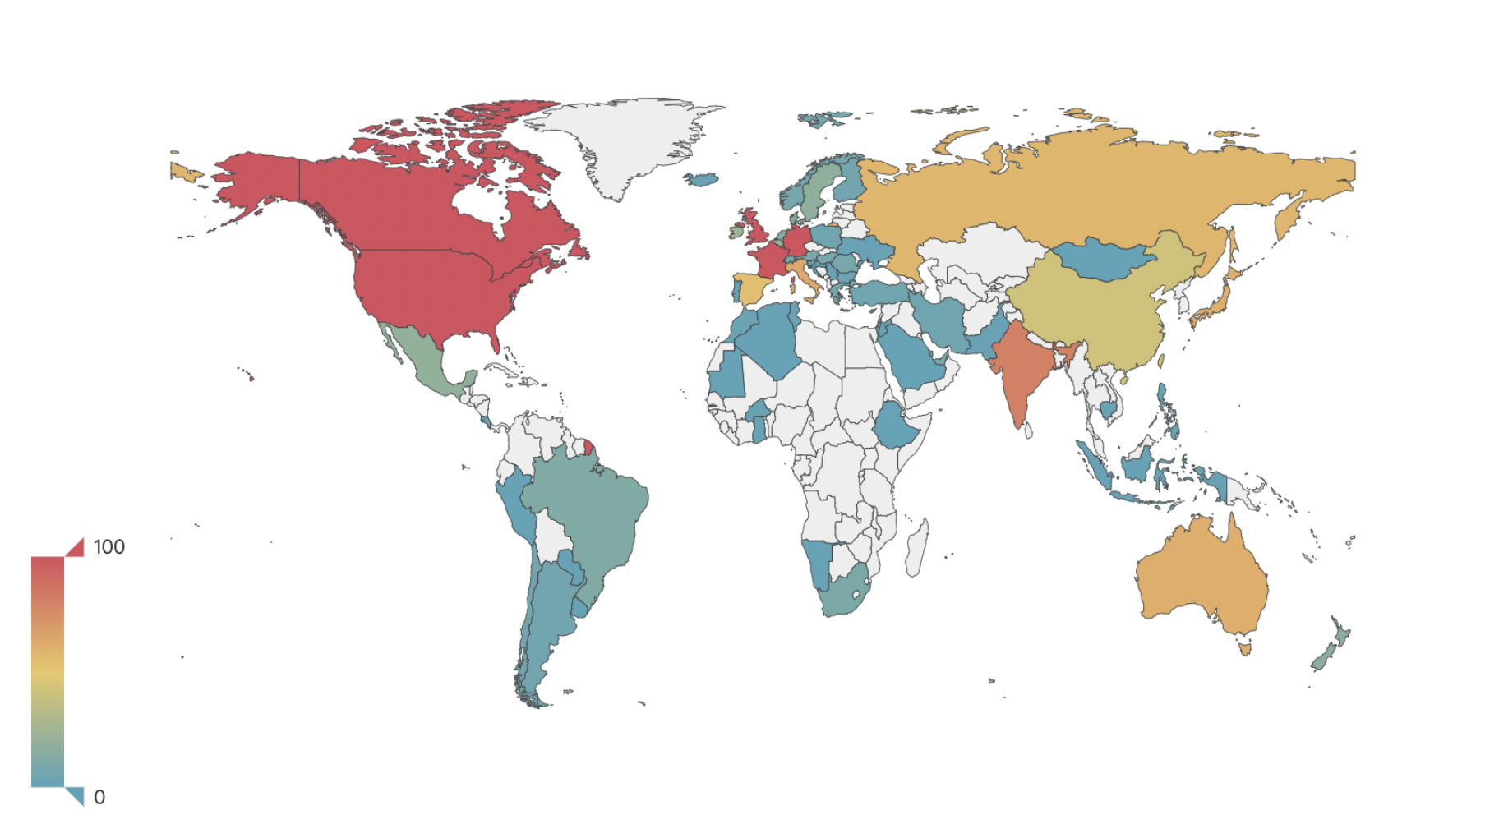
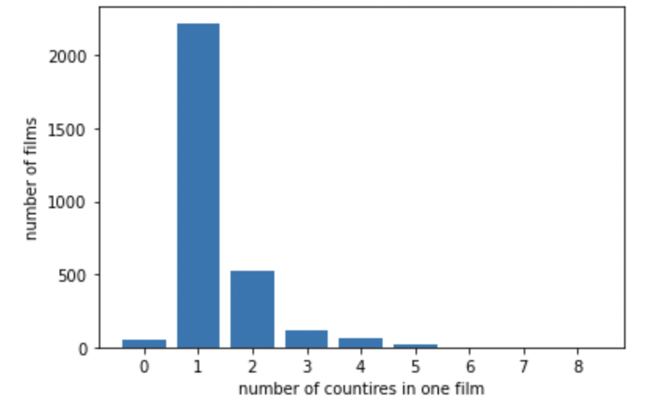
Production Countries
*To show the different color between the countries, here we set the max is 100, even though some countries are over 100
US produced most films (2282) followed by UK, France, Germany, Canada. It should be noted that most films are only produced by one country

Slide 10
Machine Learning Techniques (Proposed)
From the analysis conducted, we notice that there is no clear linear relationship between features and target variable. Therefore, we will use linear models (ridge, lasso, elastic-net) only for the purpose of creating baselines
The dataset obtained from preprocessing is extremely sparse, therefore techniques like PCA can be implemented to create a dense dataset for training. However, conducting PCA will result in loss of interpretability
Tree based models such as RandomForest, XGBoost, CATBoost can be implemented and feature importances can be analysed (before PCA). Conducting feature importance analysis after PCA will not give any interpretable information
We plan to use topic modeling for the feature “overview”, which describes movies briefly, to explore the topics of movies. The new feature “topics” would be used for the prediction of the revenue and the exploration of the development of movies with the passage of time

